Slide 1
fast.ai
. . .making deep learning cool again

Slide 2


Slide 3
what is fast.ai?
Built-in modern and optimized DL practices
Built upon PyTorch
Vision
NLP Tabular Collab
Easy, Powerful, Efficient Deep Learning library
State-of-the-art models

Slide 4
why fast.ai?
Ease of use, flexible, powerful and efficient
GPU-optimized library
Faster and more accurate
Different levels of APIs to satisfy everyone’s thirst
Documentation + community on point

Slide 5

How can I learn fast.ai?

Slide 6
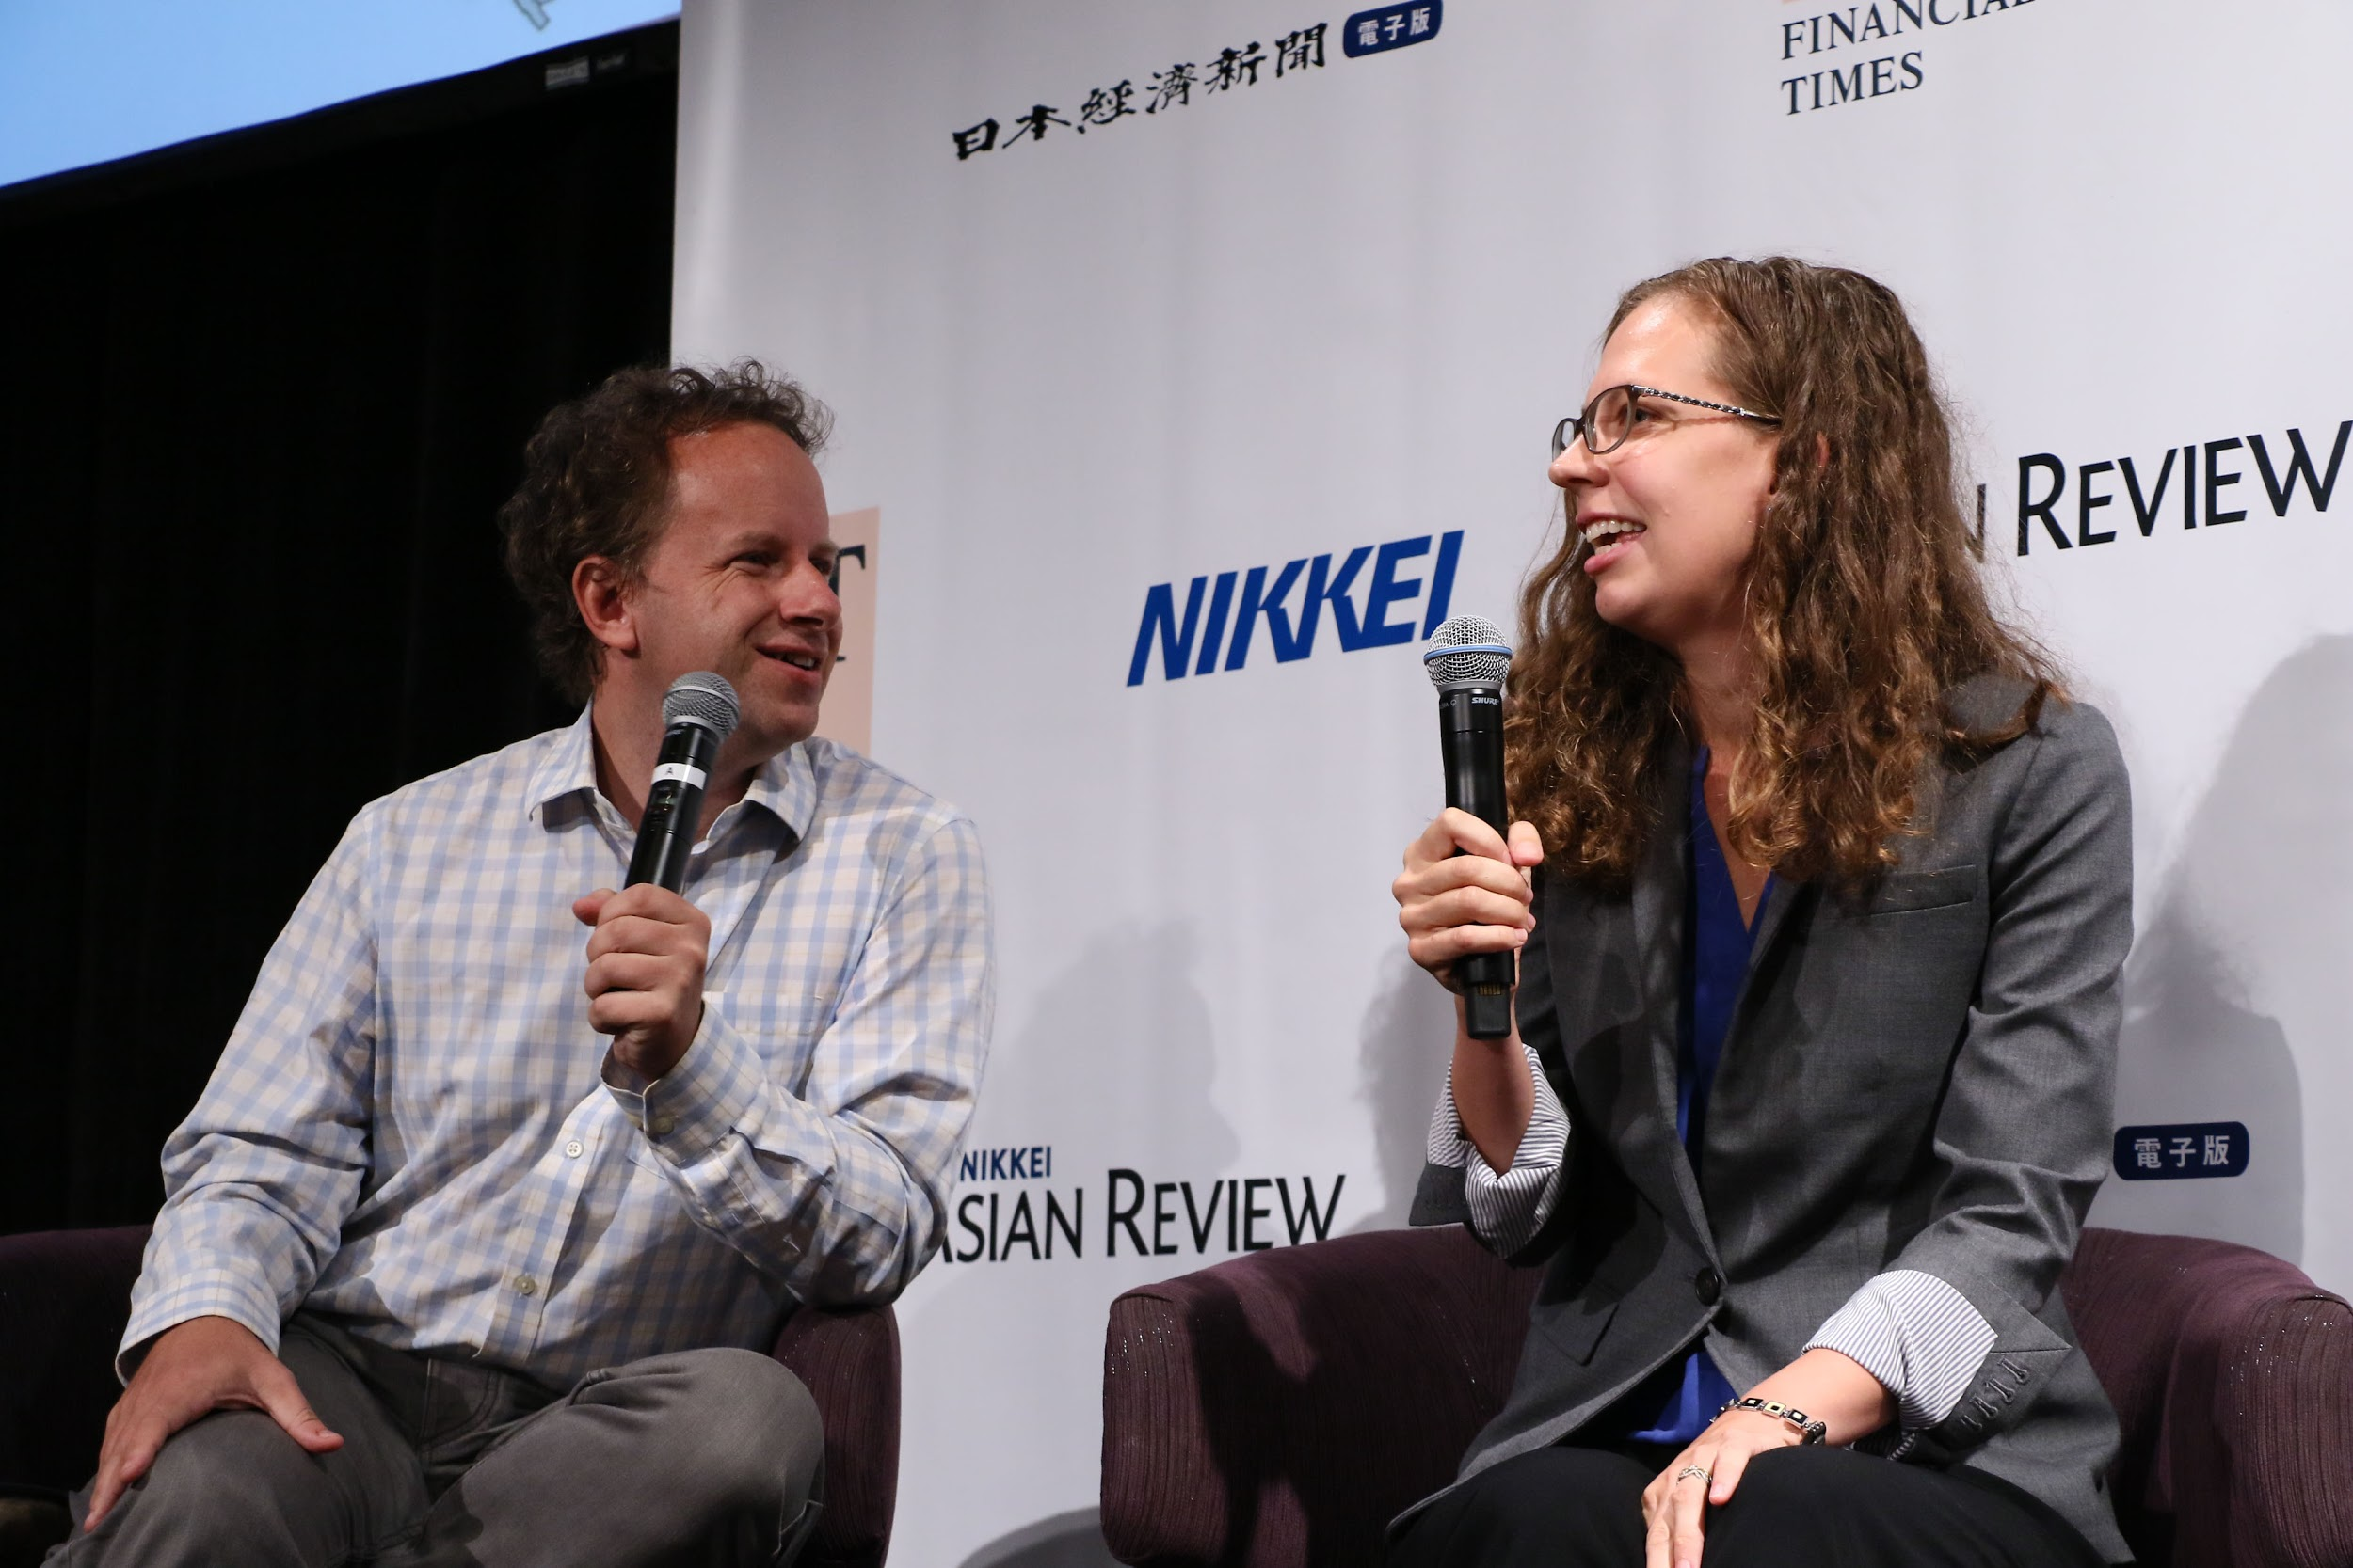
How to start fast.ai?
fastai(v2) official course: https://course.fast.ai/
Extremely active community: forum + discord
No Math background needed
Get coding from day 1!

Slide 7


Slide 8

I hope y’all are intrigued by fast.ai
Thank you for listening

Slide 9






Connect with me on
muskanlalit
muskan_lalit18
MuskanLalit18
muscan't#0957
muskan.lalit18@gmail.com

